Slide 1

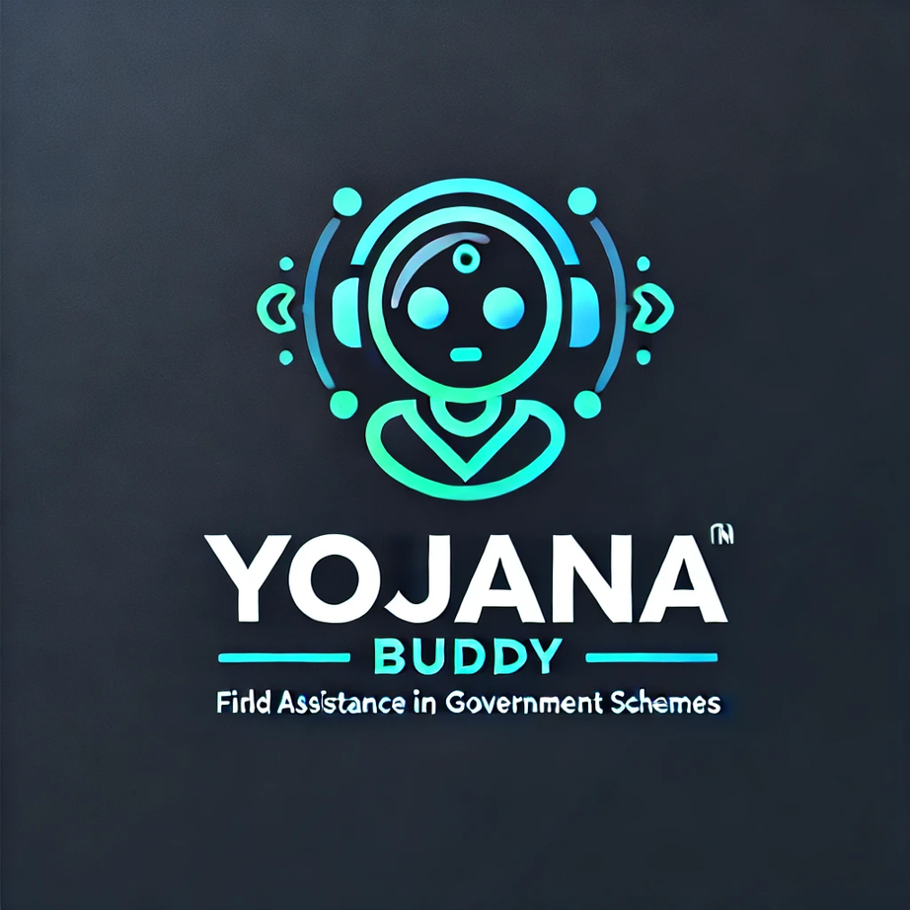
YojanaBuddy
Your buddy for all Indian government schemes
An AI-powered government scheme finder :
So the people don’t miss out on the benefits they deserve.

Slide 2


Problem Statement
AI-Powered Scheme Finder :
Create an AI tool that helps people find government schemes based on their details, so they don’t miss out on benefits they deserve

Slide 3





Meet Our Team
Our team consists of 4 members:
1) Advik Gupta
2) Adamya Rangi
3) Shivansh Singh
4) Tanisha Sharma
Advik Gupta
Adamya Rangi
Shivansh Singh
Tanisha Sharma
2nd year Btech IIITD
2nd year Btech IIITD
2nd year Btech
IIITD
1st year Btech
MDU

Slide 4

Introduction
Many individuals miss out on government schemes and benefits due to a lack of awareness, complex eligibility criteria, or difficulty in navigating official portals (the websites made by the government have very high cognitive load making it difficult to browse important information relevant to the user). Existing platforms are often fragmented, requiring users to manually search through multiple government websites or static databases. Low digital literacy further worsens accessibility issues, making it harder for underprivileged groups to avail benefits.

Slide 5

Vision & Mission
Mission
Empower Citizens – Provide a seamless and intelligent platform that helps users discover and apply for government schemes effortlessly.
Bridge the Awareness Gap – Use AI-driven recommendations to connect people with benefits they are entitled to but may not be aware of.
Enhance Accessibility – Offer multilingual, voice-enabled, and user-friendly interfaces to make scheme discovery inclusive for all, including those with low digital literacy.
Drive Social Impact – Contribute to poverty alleviation, entrepreneurship growth, and financial stability by maximizing benefit utilization.
Vision
"To ensure that no eligible individual misses out on government benefits by leveraging AI to simplify access to welfare schemes, fostering financial security and social inclusion for all."

Slide 6
Features to be Implemented
AI-Powered Eligibility Checker – Uses NLP to analyze user inputs and match them with relevant government schemes based on income, age, occupation, location, and other factors.
Application Assistance – Provides step-by-step guidance, including links to official portals and pre-filled application forms where possible.
Conversational Chatbot – A user-friendly chatbot guides users through the process of finding and applying for schemes.
Integration with Aadhaar and PAN (India-specific) – Auto-fetches details for faster eligibility verification (with user consent).
Automated Document Validator – AI scans and verifies uploaded documents to ensure compliance with eligibility criteria.
Data Privacy and Security – Ensures compliance with data protection laws, encrypting user data and offering secure authentication methods.

Slide 7
How Our Solution is Different from Other Pre-existing Solutions
AI-Driven Personalization: Unlike generic search portals, our tool dynamically tailors recommendations based on user profiles and updates in real time.
Privacy-Focused & Secure: Ensures encrypted data handling and strict compliance with government regulations, unlike some platforms that store user information insecurely.
End-to-End Application Guidance: While other tools list schemes, we go further by providing document verification, through which we show schemes that the user is eligible to apply for.
Conversational Assistance: Most existing platforms require users to search manually, whereas our AI chatbot simplifies the process through an intuitive conversation-based approach.

Slide 8

Frontend: HTML+CSS+Javascript
Backend: Node.js
Database: PostgreSQL
AI & ML: OpenAI GPT-4 / Google BERT for NLP processing, Scikit-learn for eligibility classification and Tensorflow
Tech Stack

Slide 9

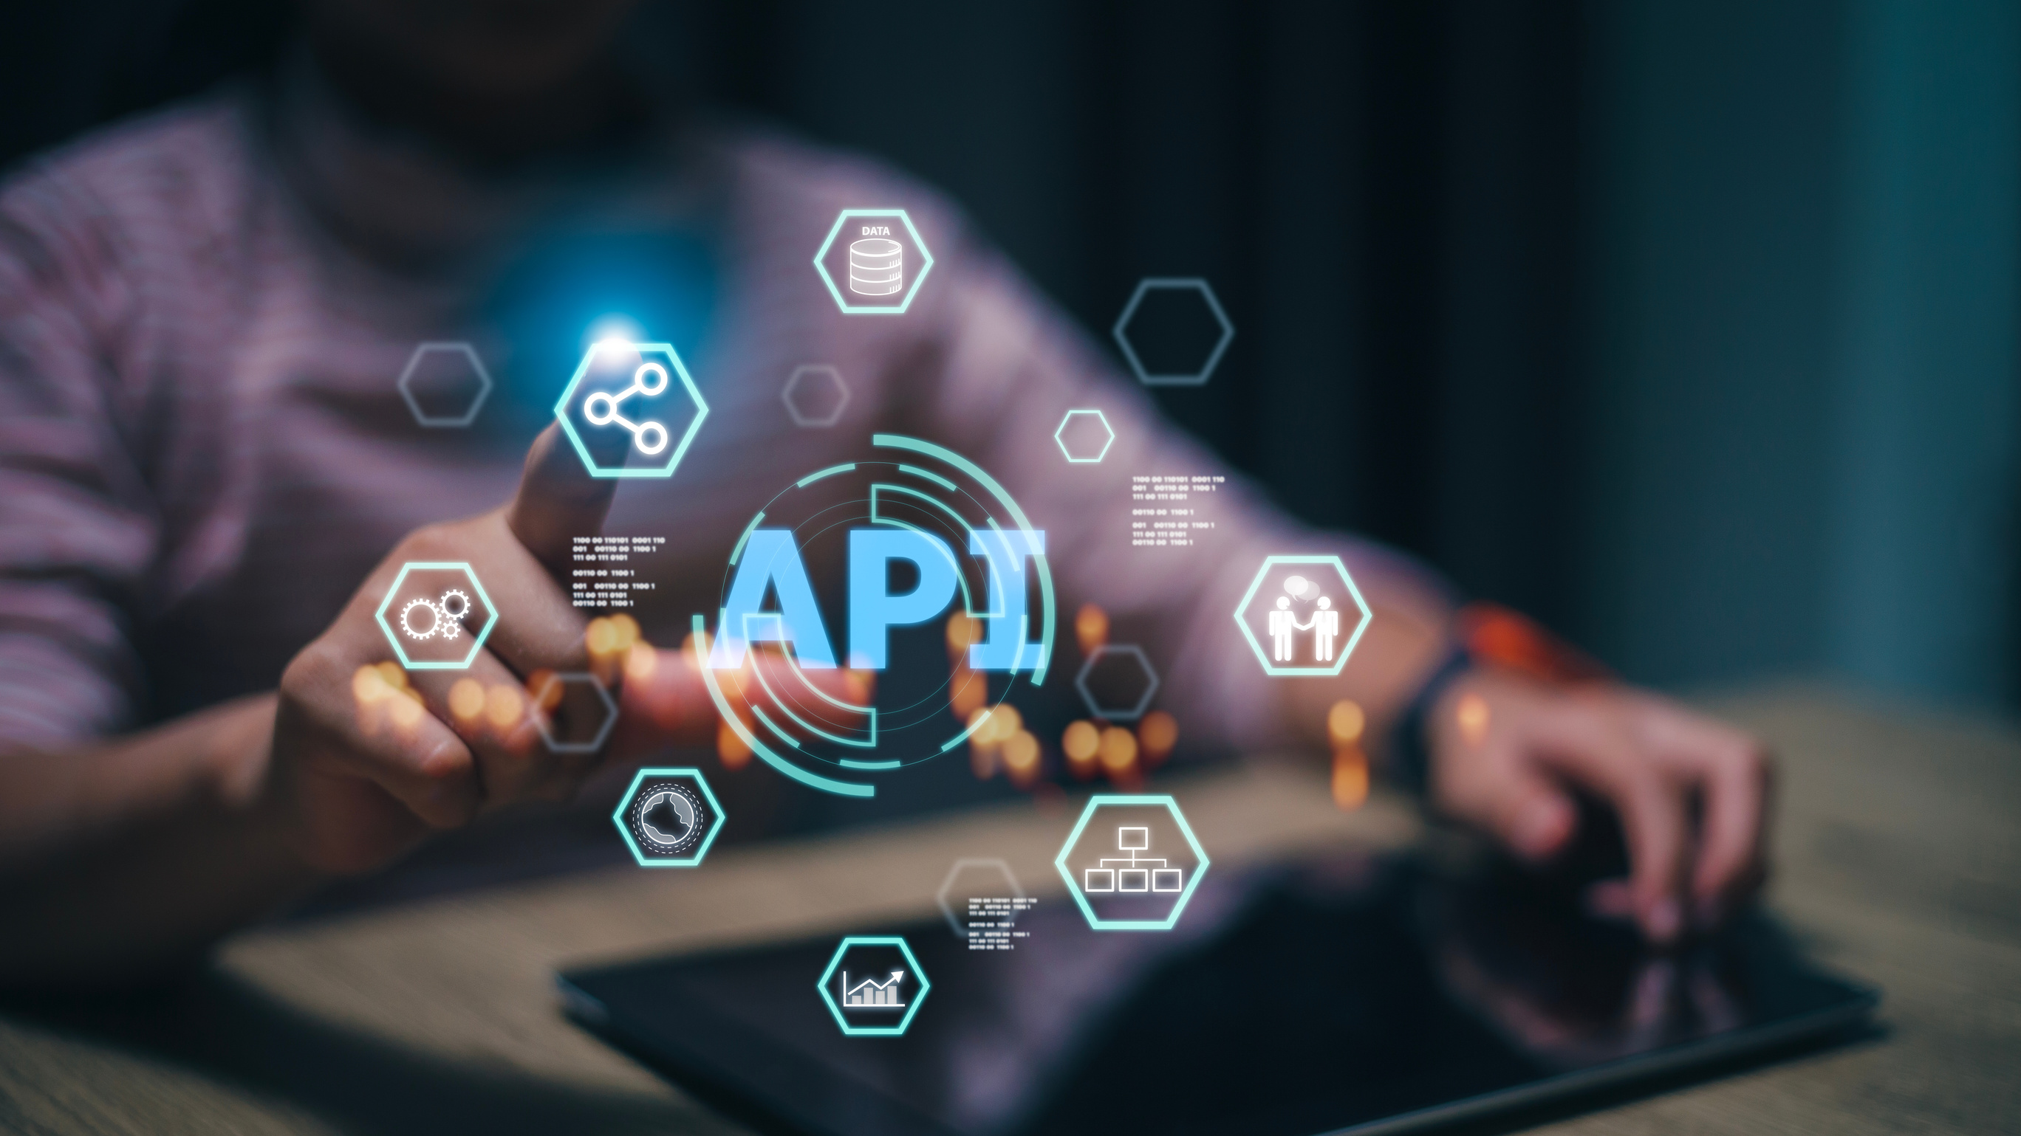
Thank You!

